Slide 1
COURAGEOUS ADVOCATE of the WEEK
Joni Eareckson Tada

Slide 2
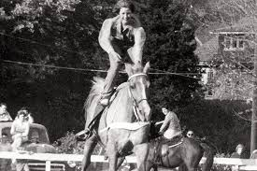
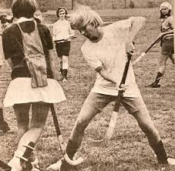
Joni (pronounced Johnny) lived a very active life all through her growing up years. She enjoyed riding horses, hiking, tennis, and swimming. When she was 17, Joni broke her neck, in a diving accident (she misjudged how deep the water was) and became a quadriplegic, meaning she was paralysed from the shoulders down and can’t use her legs, arms or hands.
Photos from
before Joni’s
accident

Slide 3

Joni had to spend a VERY long time, lying face down, in the hospital.
She spent much of her time talking to God.
What would you do if one day, you woke up unable to use your arms, legs or hands?
Would you get angry with God?
Would you thank Him?
Would you question Him?
Would you ignore Him?

Slide 4
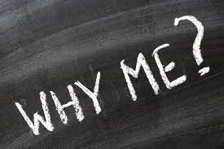
Joni has been in a wheelchair since her accident, 54 years ago.
At first, Joni was very angry with God and was very sad and depressed. She asked God, WHY He allowed this to happen to her.

Slide 5
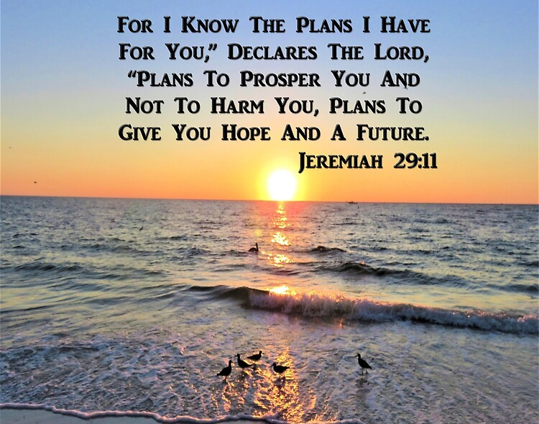
Many visitors came to visit Joni in hospital.
One Christian friend shared this verse from the Bible.

Slide 6
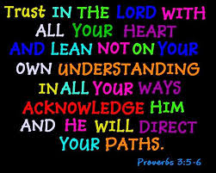
Joni made a choice to put her trust in God and believe that He had a plan for her life…
He certainly did…and He certainly does…

Slide 7
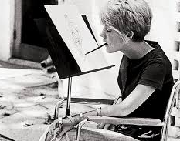
Joni is still in a wheelchair and still suffers terrible pain, she has had cancer and has even recently recovered from Covid! but…
Over the years, she learned to paint with her mouth!

Slide 8
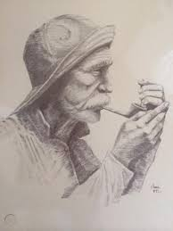
Here are some of Joni’s pictures…

Slide 9
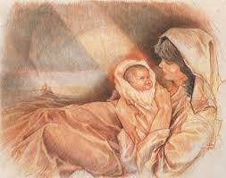

Slide 10
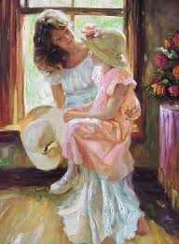

Slide 11
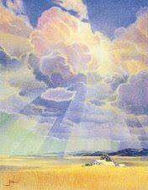
Maybe you could try painting
a picture with your mouth

Slide 12
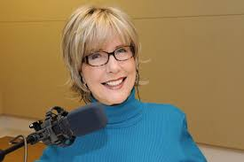
Joni has not only become a wonderful artist, but she is also a…
Radio Broadcaster, who has given over
10,000 messages on the radio.

Slide 13


Joni has written over 50 books, including her most popular title,
“Joni: An Unforgettable Story”.
This book was a huge inspiration for
Mrs Seagrave, when she read it as a teenager.
Joni has written several popular children’s books too.

Slide 14

Joni is also the founder of an organisation called
Nearly 1 billion people around the world live with disabilities.
Many of these people and their families live in poverty, pain,
and despair.
“Joni and Friends” is committed to bringing the Good News of Jesus, and practical help to people affected by disability all around the globe.

Slide 15
When thinking about God, in her hospital bed, Joni did question,
“Is He really good?”
over the years, she says she has found that,
“He is always good.”

Slide 16
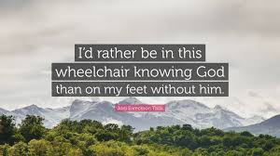
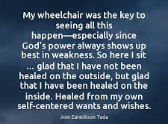

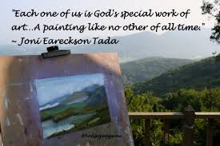
Some of Joni’s quotes to think about…

