Slide 1
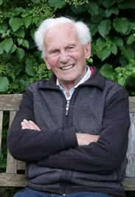
COURAGEOUS ADVOCATE of the WEEK
Bijl - Brother Andrew 1928 -

Slide 2
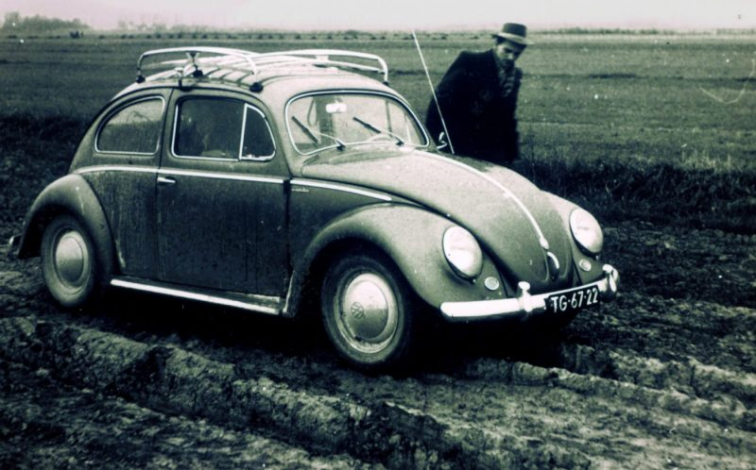
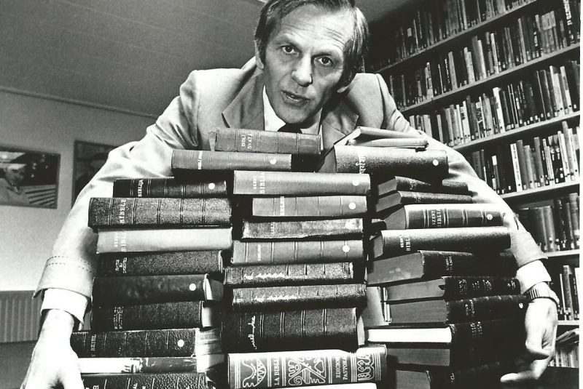

Slide 3
In 1955 visited Communist Poland – Behind the Iron Curtain
Special Bible Verse: "Wake Up! Strengthen what remains and is about to die." Revelation 3:2
God’s Smuggler
“The real calling,” he has said, “is not a certain place or career but to everyday obedience. And that call is extended to every Christian, not just a select few.”

