Slide 1
COURAGEOUS ADVOCATE of the WEEK
Chris Gardner

Slide 2
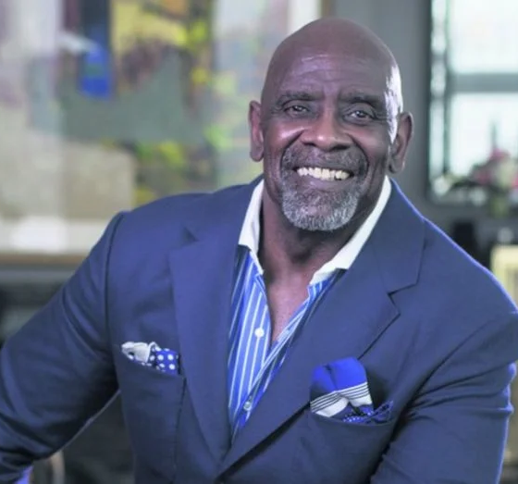


Chris Gardner sponsors many charities including:
the Cara Program which offers job training and permanent job placements to homeless people.
the Glide Memorial United Methodist Church in San Francisco (where he and his son received desperately needed shelter when they were homeless).
He donates clothing and shoes to the homeless.

Slide 3



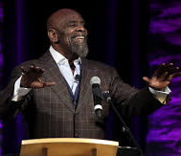
My faith is one of the strongest guiding forces in my life.
I talk to God everyday.
I was homeless but I wasn’t hopeless. I knew a better day was coming from God.
Each day I look to God and ask him what he wants me to do.
Special Bible Verse:
Nothing can stop God’s plans for your life. Isaiah 14:27

Slide 4
