Slide 1
COURAGEOUS ADVOCATES of the WEEK
Ian and Margaret Dickson

Slide 2
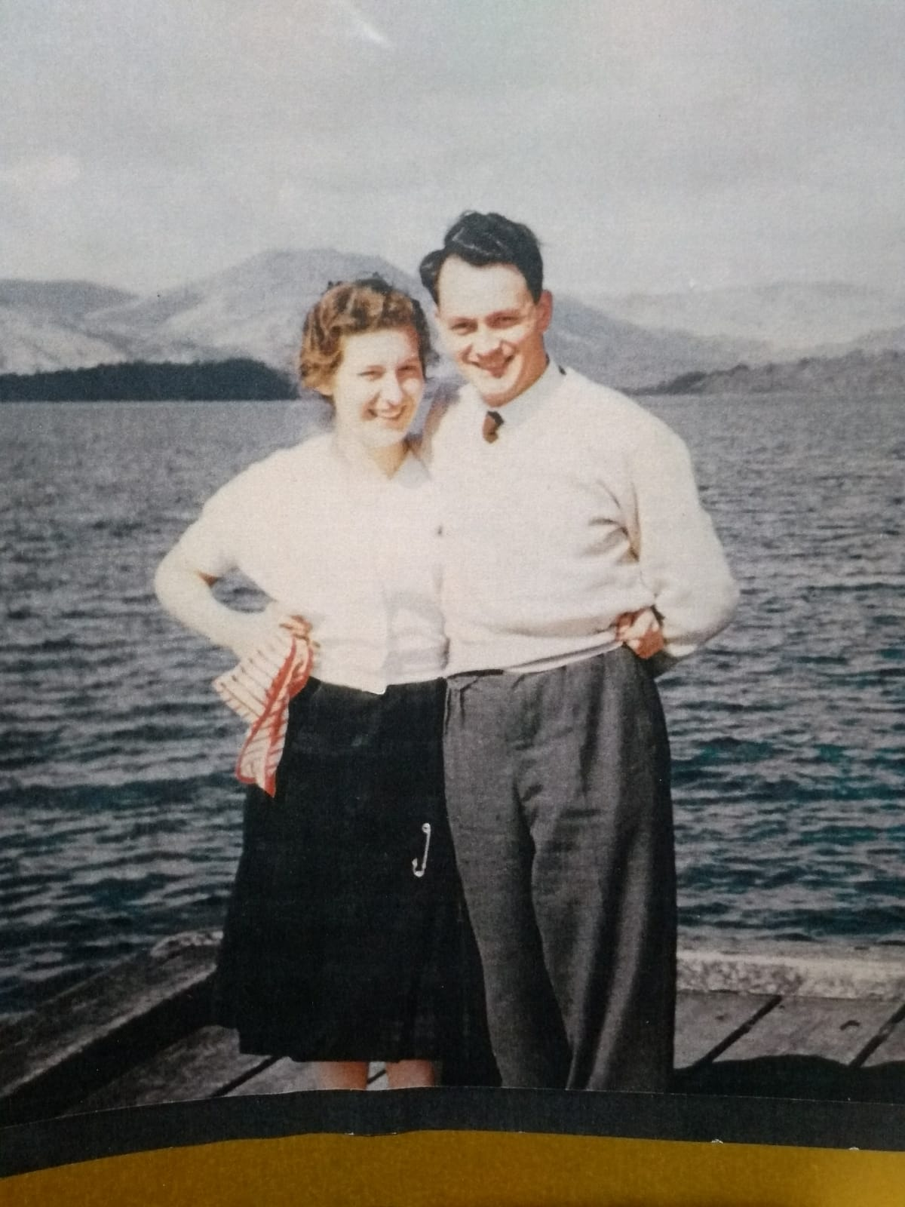
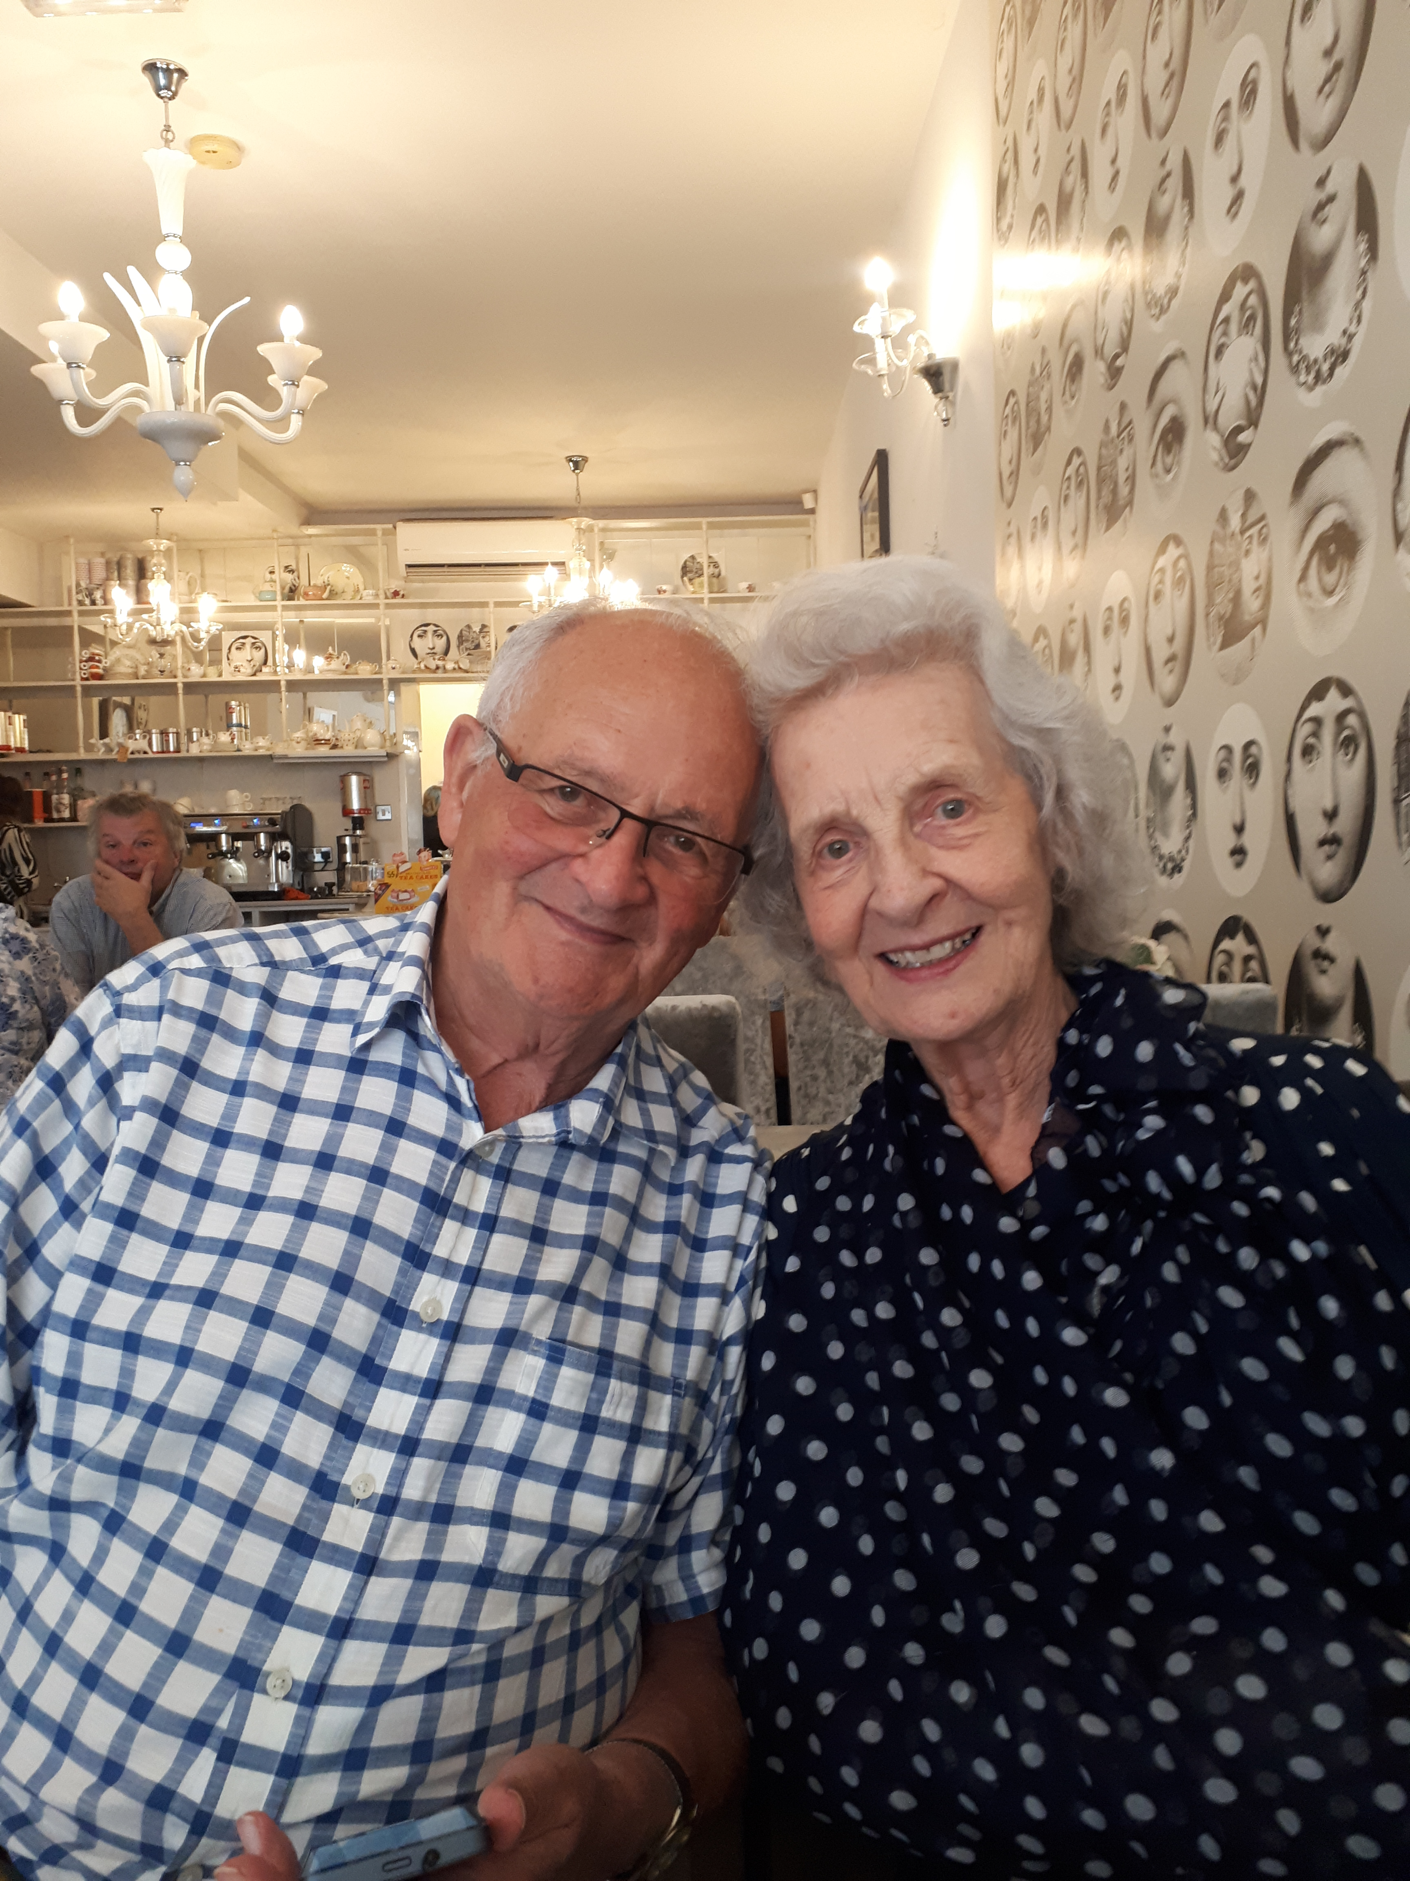
Loch Lomond - c1960 Bertie’s Café, Lytham 2019

Slide 3
Sharing God’s love, as a couple for nearly 60 years in both the UK and West Africa
Sharing the love of Jesus in The Gambia for 25 years
Pastors at Preston City Mission for 32 years (now 85 and 86)
Special Bible Verse: “As your days so shall your strength be.” Deuteronomy 33:25

