Slide 1
Welcome to Reception

Slide 2

https://www.leacofe.lancs.sch.uk/website/
At Lea Endowed Church of England School we provide an excellent education for our children. We follow God’s example, by loving Him, and each other, in all that we do. Our whole school family is encouraged to achieve their full, God given potential and shine in their own special way.
“Let your light shine.” Matthew 5:16

Slide 3
Key Staff
Mrs Moores
Mrs Gingell
Mrs Walton

Slide 4
Structure of the day
8.45 School opens
8.50 Register and lunch choices; daily board
9.00 Phonics & Guided Reading
10.00 Snack
10.20 Break time
10.40 Worship – whole school or class
10.45 Maths
12.00 Lunch
1.15 Afternoon lessons

Slide 5
Special Days
Tuesday – Computing Day
Online Safety – we are very careful in school; please check parental controls & supervise children when online, even on Kids YouTube.
Wednesday – Library Day, Homework Show & Tell day
Thursday – PE Day (Earrings to be removed please)
- Reading books, phonics books & homework come
home
Friday – Forest Friday (wellies as the weather gets worse)

Slide 6
Homework – sent home each Thursday
Each half term there is a new homework grid that links with the topics we are doing in class.
Homework - to return to school each Thursday for Show and Tell. Photos & videos can be emailed to me.
Phonics book – the phonemes we have learned and words/sentences we have read.
Reading books go home each Thursday after being read 3 times with a teacher in class.

Slide 7
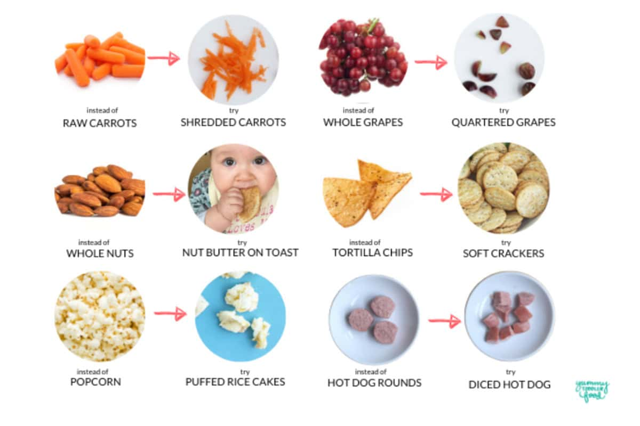
Safe foods

Slide 8
Recepti
Reception Baseline
The Reception Baseline Assessment (RBA) is a short, interactive and practical assessment of your child’s early literacy, communication, language and mathematics skills when they begin school.
It will be used to measure your child’s progress from Reception to Year 6. The data will only be accessed by the DfE, and is not shared with school, parents or external agencies.
It is an opportunity to get to know the children and learning their strengths and next steps.
When your child reaches Year 6, you will be able to see the progress the year group has made throughout their school journey.
If you wish to read further on the Reception Baseline, then you can find a useful parent booklet here;
https://www.gov.uk/government/publications/reception-baseline-assessment-information-for-parents

Slide 9
Seesaw
Letters will be sent out this week with your unique QR code.
Provides a snapshot of what your child is doing in school.
Some observations will be just your child, others will be for the class or group they are working in.
Accessible to extended family as well.
Please let us know if there are any problems setting it up.

Slide 10
Things to remember …
Water bottles every day (just water please unless other arrangements have been made)
Healthy snack (no nuts or products containing nuts please)
Ruck sack or book bag (small enough to fit on pegs)
Correct uniform, clearly labelled please.
Small hair accessories please – no big bows or ribbons.
No smartwatches please.

Slide 11
Other bits and bobs
Birthdays are special! Staff will happily hand out invitations/thank you cards. It’s fine to send in treats on a birthday – please check ingredients.
Long hair to be tied back please.
Label absolutely everything! Please check regularly that names haven’t washed out.
Text message service should be live – please speak to Mrs Lynne Ruston in the office if there are any problems.
Open Door is each MONDAY. Please pop in if you want to look at the classroom displays or work your child has done.
My email is on the homework sheet
j.moores@leacofe.lancs.sch.uk

