Slide 1
The Eatwell Guide

Slide 2
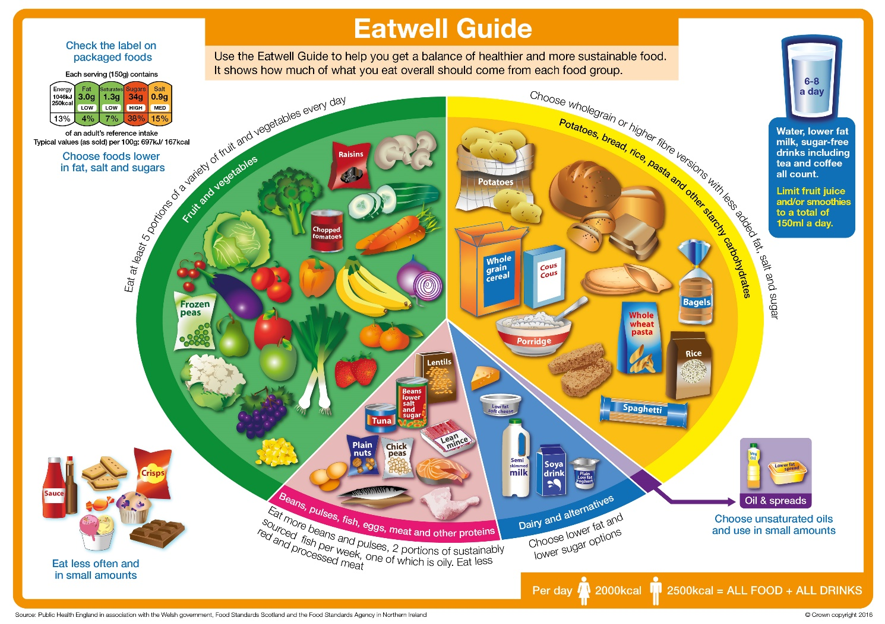
The Eatwell Guide
What can you see?
This is the Eatwell Guide.
It shows the proportions and types of food that should be eaten.
It has 5 main food groups.

Slide 3
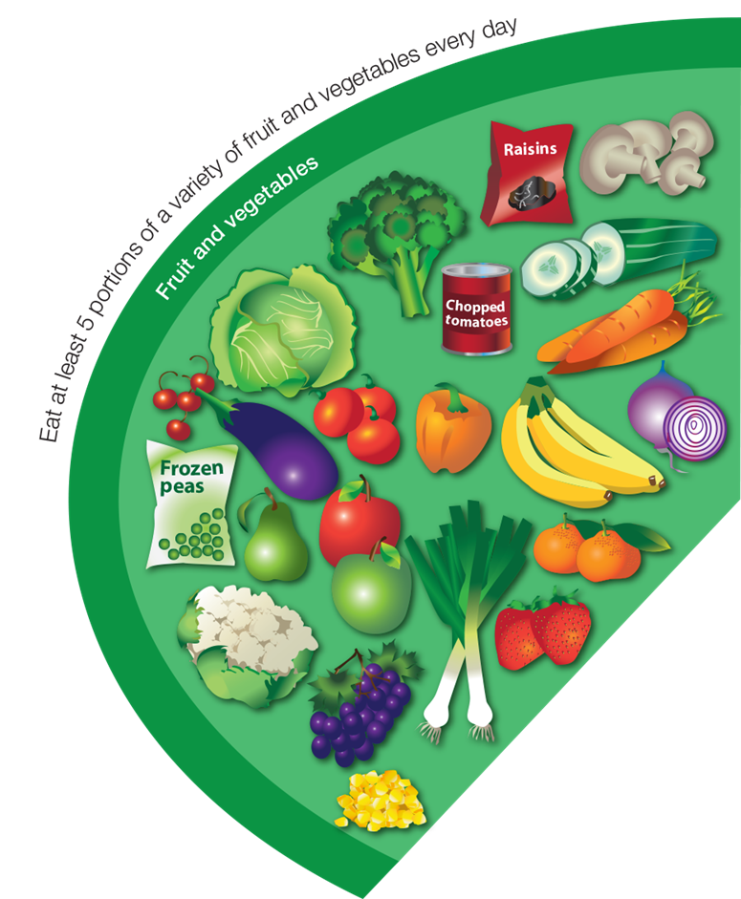
Fruit and vegetables
What food can you see here?
How much do you need to eat from this food group?
Eat at least five portions every day.

Slide 4
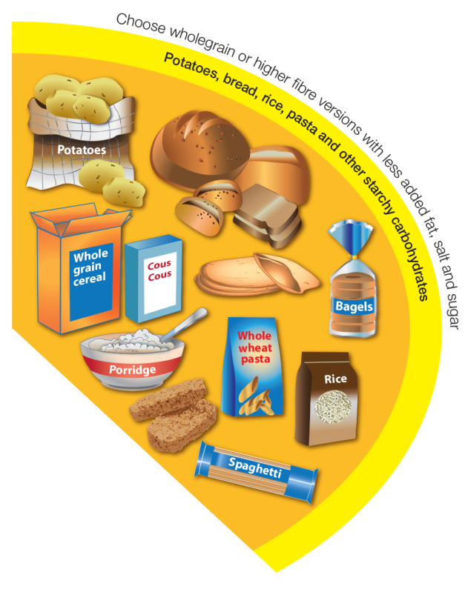
Potatoes, bread, rice, pasta and other starchy carbohydrates
What food can you see here?
How much do you need to eat from this food group?
Eat a food from this group at every meal time.
Try wholegrain varieties.

Slide 5
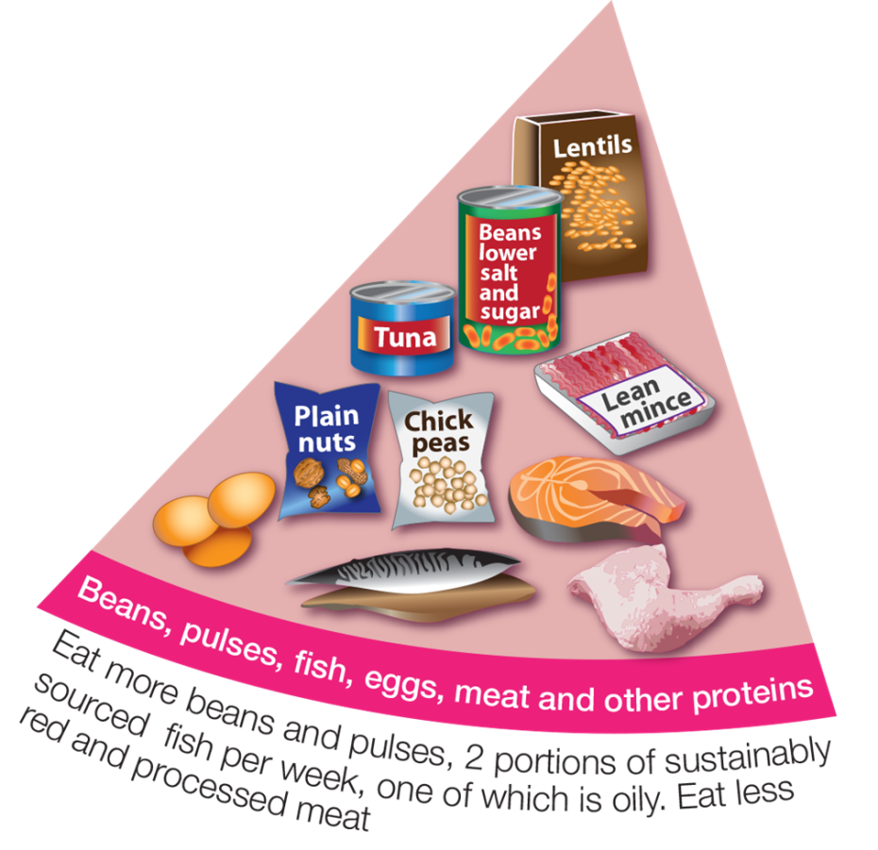
Beans, pulses, fish, eggs, meat and other proteins
What food can you see here?
How much do you need to eat from this food group?
Eat some foods from this group every day,
e.g. beans on toast or spaghetti Bolognese.

Slide 6
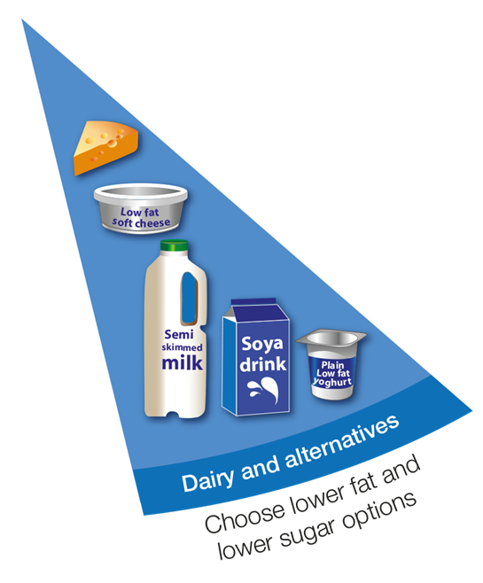
Dairy and alternatives
What food can you see here?
How much do you need to eat from this food group?
Have some of these foods every day,
e.g. a pot of yogurt and a cheese sandwich.

Slide 7
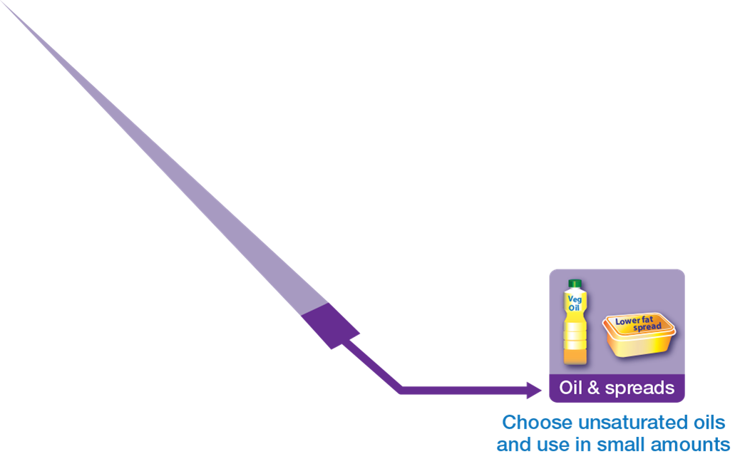
Oil and spreads
What food can you see here?
How much do you need to eat from this food group?
Eat in small amounts

Slide 8
Drinks
How many drinks do you need each day?
What drinks are healthier choices?
Water and lower fat milk are healthier drink choices!
You can have 150ml of juice or smoothie a day.

Slide 9
Foods high in fat, salt and sugars
What food can you see here?
Do you need this type of food to be healthy?
You do not need this type of food to be healthy. If eaten, have less often and in small amounts.

Slide 10
For further information, go to:
www.foodafactoflife.org.uk

