Slide 2
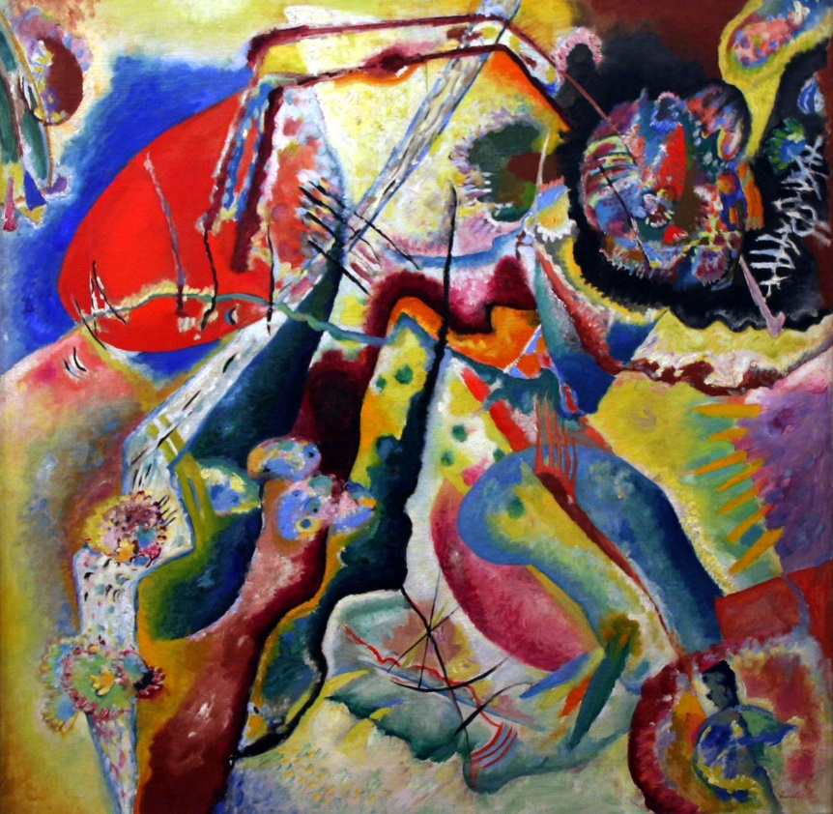
Wassily Kandinsky (1866 - 1944)
Wassily Kandinsky was a Russian painter.
Many people think he was
the first abstract artist.
Abstract art is a combination of colours, lines, and shapes that are not meant to be realistic.
Abstract Painting
by Wassily Kandinsky
Photo courtesy of Playing Futures: Applied Nomadology (@flickr.com) - granted under creative commons licence – attribution

Slide 3
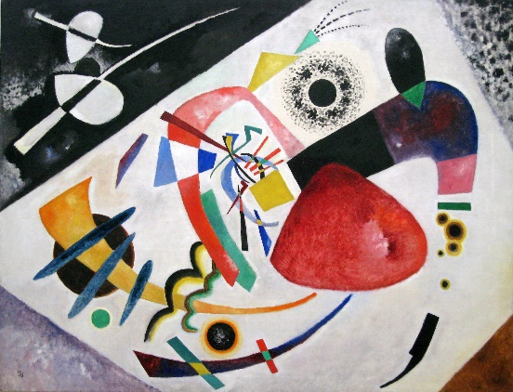
Red Spot II (1921)
by Wassily Kandinsky
Photo courtesy of Sharon Mollerus (@flickr.com) - granted under creative commons licence – attribution

Slide 4
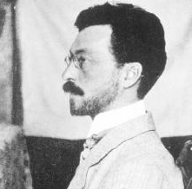
All About Wassily Kandinsky
Wassily Kandinsky was born in Russia on the 4th December, 1866. When he grew up, he worked as a university teacher, but it didn’t make him happy.
When he was 30, he left his job and went to art school. He found art school easy and excelled at his studies.
Kandinsky thought a lot about colors and how they make people feel. He believed that colours had a soul.
Wassily Kandinsky

Slide 5
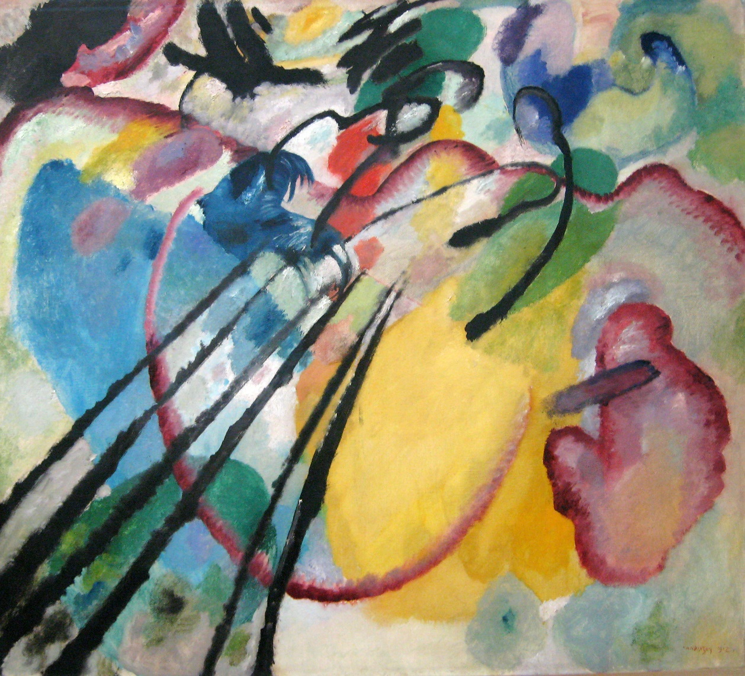
Improvisation 26 (Rowing) (1912)
by Wassily Kandinsky
Photo courtesy of Sharon Mollerus (@flickr.com) - granted under creative commons licence – attribution

Slide 6
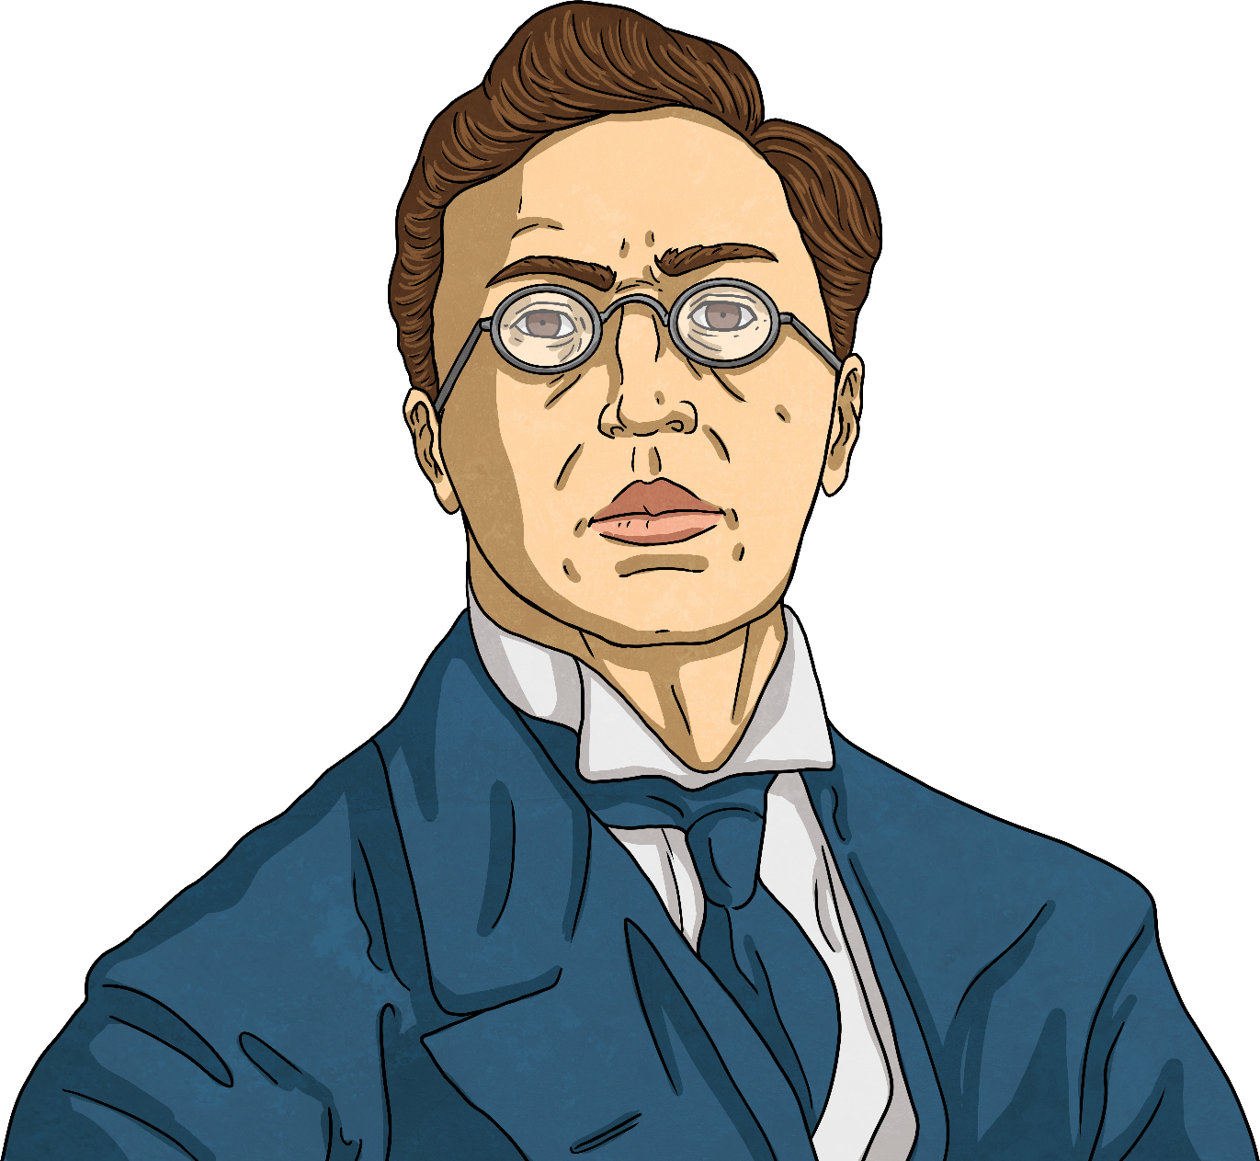
All About Wassily Kandinsky
Kandinsky was the first painter to stop painting pictures of real things and instead paint just using colours and shapes. He believed that this let him paint honestly about his feelings.
Often Kandinsky would listen to music while he painted and try to paint what he heard.
Other painters that came after him learned a lot from Kandinsky’s ideas.

Slide 7
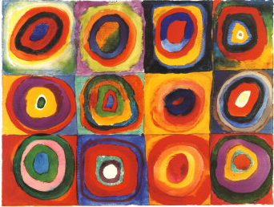
Squares with Concentric Circles (1913)
Let’s Talk!
What do you see when you look at this painting?
How has the painting been made?
What kind of colours does Kandinsky use?
How would you describe these colours?
What shapes can you see?
What lines can you see?
How do you think Kandinsky was feeling when he painted this?
How does the painting make you feel?
Do you like it? Why?
Photo courtesy of NailsandNoms (@flickr.com) - granted under creative commons licence – attribution

Slide 8
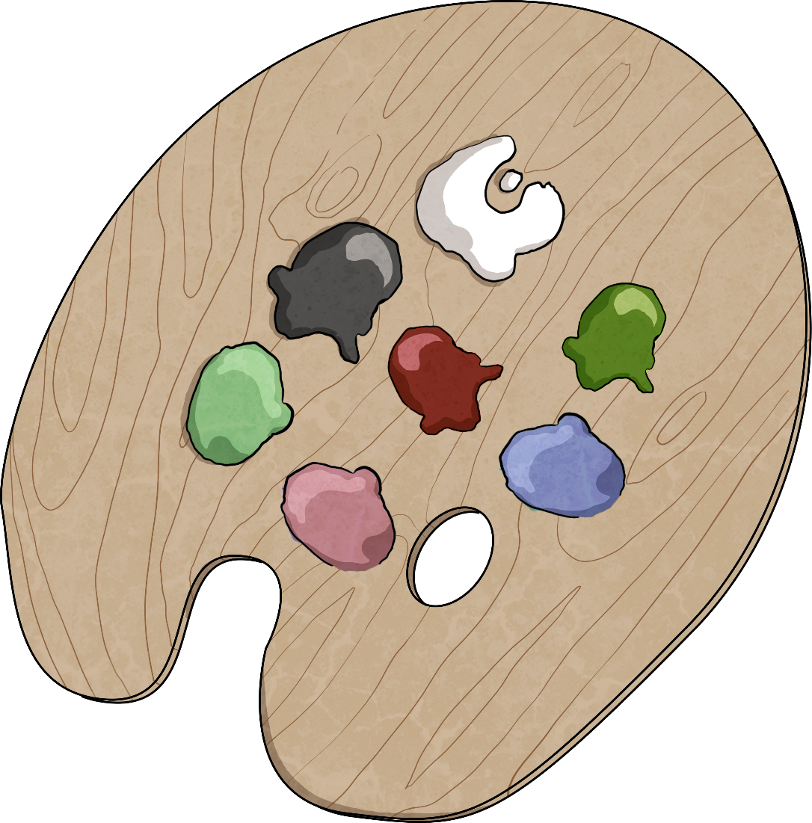
Before we paint, let’s learn about… Colour Mixing

Slide 9
Primary Colours
Primary colours cannot be made by mixing other colours.
The primary colours are red, yellow, and blue.
Primary colours can be mixed together to make other colours.

Slide 10
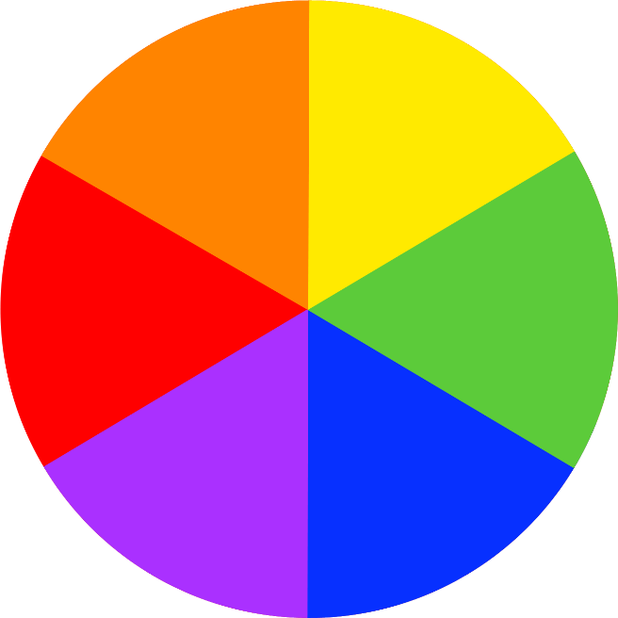
Secondary Colours
You use
primary colours to make secondary colours.

Slide 11
Mixing Secondary Colours

Slide 12
Mixing Tints
If you add white to a colour, you can make tints of the original colour.
White makes the colour lighter.

Slide 13
Mixing Shades
If you add black to a colour, you can make shades of the original colour.
Black makes the colour darker.

Slide 14
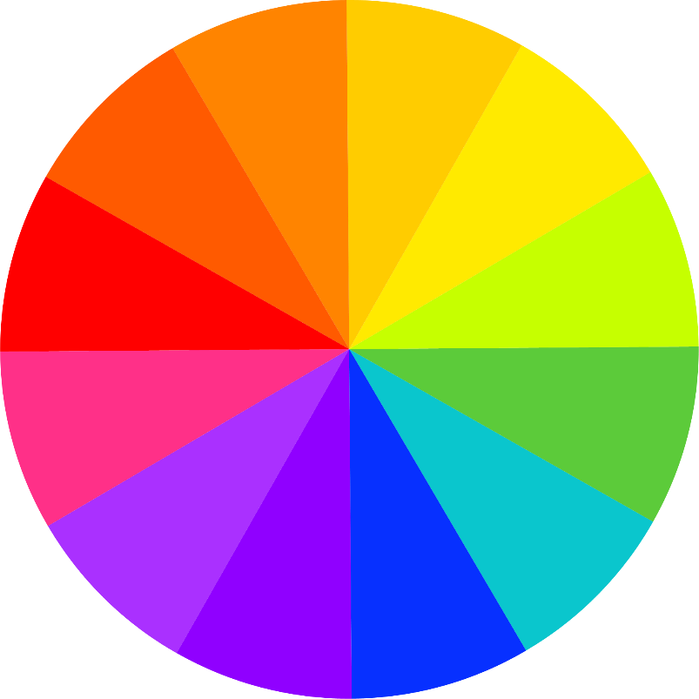
Warm and Cool Colours
warm colours
cool colours
-----------------------------

Slide 15
Warm Colours
Cool Colours
Red, orange, and yellow are warm colours. They make us think of sun, warmth, and cozy things.
Green, blue, and purple are cool colours. They make us think of fresh, calm, and chilly things.

Slide 16
Kandinsky Circle Painting
You will need…
paper folded into four squares
coloured paint
brushes
water
Experiment with mixing colours together. Use white to make them lighter and black to make them darker. Make some colours that you like.
In each square of your template, paint a dot. Use a different colour for each one.
Around each dot, paint a circle in a different colour.
Around each circle, paint a larger circle in a new colour.
Finally, fill in any white space you have left in each square in another colour.

Slide 17
Kandinsky Painting Challenge
Why not try doing your own concentric heart painting?
Try experimenting with other shapes and see what you can do. Enjoy and have fun! Don’t forget to end in your photos.

