Slide 1
COURAGEOUS ADVOCATE of the WEEK
Reverend Billy Graham
https://www.youtube.com/watch?v=zucUa13ciOM

Slide 2
Reverend Billy Graham 1918 - 2018

Slide 3
200 million people

Slide 4
200 million people
185 countries
.

Slide 5
200 million people
185 countries
He lead hundreds of thousands of people to pray to receive Jesus Christ into their lives as Lord and Savior.

Slide 6
His offered spiritual support and guidance to all the United States presidents from President Eisenhower to President Bush

Slide 7
His offered spiritual support and guidance to all the United States presidents from President Eisenhower to President Bush
"One of the Ten Most Admired Men in the World,”

Slide 8
His offered spiritual support and guidance to all the United States presidents from President Eisenhower to President Bush
"One of the Ten Most Admired Men in the World,”
A record-breaking 59 times !!!!

Slide 9
“the Bible says,”

Slide 10
For God so loved the world that He gave his only begotten Son that whosoever believeth in Him should not perish but have everlasting life. John 3v16

Slide 11
The Reverend Billy Graham preached God’s Word with conviction and passion for over 60 years.

Slide 12
“God never takes away something from your life without replacing it with something better.”
“Take one day at a time. Today, after all, is the tomorrow you worried about yesterday.”
"God has given us two hands, one to receive with and the other to give with."

Slide 14
“Sin is the second most powerful force in the universe, for it sent Jesus to the cross. Only one force is greater—the love of God.”
“Being a Christian is more than just an instantaneous conversion – it is a daily process whereby you grow to be more and more like Christ.”

Slide 15
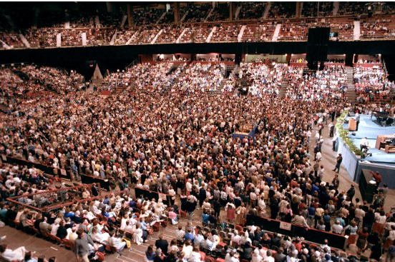
Billy Graham preached to more than 375,000 people gathered in London

Slide 16
375,000 people in London

Slide 17
375,000 people in London 800,000 people

Slide 18
375,000 people in London 800,000 people 247 "live-link" centers throughout the UK and the Republic of Ireland

Slide 19
375,000 people in London 800,000 people 247 "live-link" centers throughout the UK and the Republic of Ireland 16,000 sites in 13 nations of Africa

Slide 20
He is among the most influential Christian leaders of the 20th century.

Slide 22
210 million people

Slide 23
210 million people
185 countries

Slide 24
“Being a Christian is more than just an instantaneous conversion – it is a daily process whereby you grow to be more and more like Christ.”

Slide 25
We will listen to one of Billy Grahams favourite songs as we lead out https://www.youtube.com/watch?v=v9oRay5YBHg

Slide 26
Billy Graham preached the message of Christ’s freedom and forgiveness around the world, reaching over 200 million people in more than 185 countries. He lead hundreds of thousands of people to pray to receive Jesus Christ into their lives as Lord and Savior.
He was a friend to celebrities, politicians, athletes, and leaders, such as Martin Luther King, Jr., Bono, Muhammad Ali, Johnny Cash, Larry King, and WWII hero and Olympian Louis Zamperini.
His integrity and wisdom opened doors to offer spiritual support and guidance for United States presidents from Eisenhower to Bush
Billy Graham was named by Americans as "One of the Ten Most Admired Men in the World,” a record-breaking 59 times
He was well known for his phrase saying “the bible says” with his favourite bible verse being For God so loved the world that He gave his only begotten Son that whosoever believeth in Him should not perish but have everlasting life. John 3:16
“My favorite verse of Scripture was taught to me by my mother when I was just a little boy.
This is the one Scripture that he would always preach on a crusade, As Billy Graham said himself “The word “whosoever” in this verse means the whole world. Whatever the color of a person’s skin, whatever language he speaks, God loves him and God is willing to save him. Billy Graham thought this was marvelous – He also said he liked that the bible verse says that life doesn’t begin when you die, it begins here and now.”
The Reverend Billy Graham preached God’s Word with conviction and passion for over 60 years. Here are just a few of his words of wisdom.
He didn’t just preach to the 375,000 people in london Billy Graham preached from London to more than 800,000 people gathered at 247 "live-link" centres throughout the UK and the Republic of Ireland, and to 16,000 sites in 13 nations of Africa. He is among the most influential Christian leaders of the 20th century. He held large indoor and outdoor rallies with sermons that were broadcast on radio and television. Graham preached to live audiences of 210 million people in more than 185 countries

Slide 27
“Being a Christian is more than just an instantaneous conversion – it is a daily process whereby you grow to be more and more like Christ.” That quote is a personal favourite, and there is a reason for that ……and a reason I have chosen Billy Graham I have seen him I have been to one of his sermons, I have been to see him live in London I was in High school, 16 years old and I persuaded my friends to see Billy Graham preach in London during the summer of 1989. I thought this would be a really special day and that my friends would finally see how good the God I believed in was and how wonderful it is to be a Christian. Unfortunately it didn’t go to plan My friends tutted and laughed, they commented at how they had wasted their time coming with me, It was then I realised that Billy Graham was right - Being a Christian IS more than just an instantaneous conversion, it IS a daily process and the daily process is showing the people you meet that being a Christian is wonderful and knowing the love of God is an amazing thing ! Dear Lord Please help each and every one of us to lead a Christian life in your love, following the path of our saviour Jesus. We praise and thank you for the strength you have given to help us grow to be more and more like Christ. Amen

