Slide 1
COURAGEOUS ADVOCATE of the WEEK
Thomas Dorsey

Slide 2
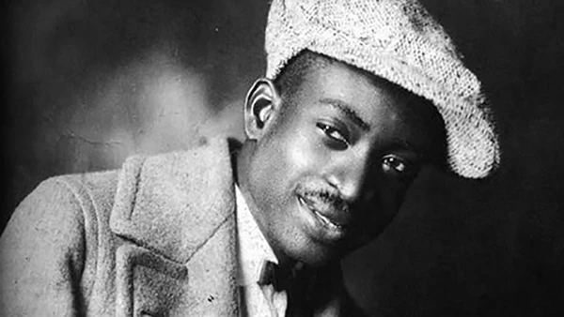
Thomas Andrew Dorsey was an American musician, composer, and Christian who was influential in the development of early blues and 20th century gospel music.

Slide 3
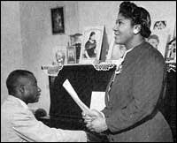
Thomas Dorsey was born in 1899 and was the son of a preacher. As a young boy, Thomas learned to play the piano from his mother, and was soon walking 30 miles to take formal music lessons. As he improved, he began earning money for his family by playing in churches and at events.

Slide 4
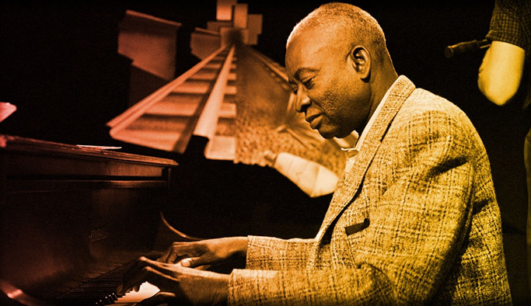
Dorsey was influenced by ‘Blues’ music, and his talent soon saw him playing with well known Blues bands all across America.

Slide 5
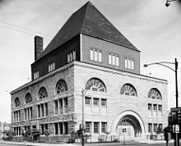
Although Dorsey was doing well, tragedy was about to strike. Both his wife and newborn son died. Through his grief, Thomas decided to dedicate his musical gifts to the Church. He definitely added his own style! “I wasn’t trying to change it [church music], but I was just struck with something that would change it over, something that God gave me. He accepted it; I got my authority from God.”

Slide 6
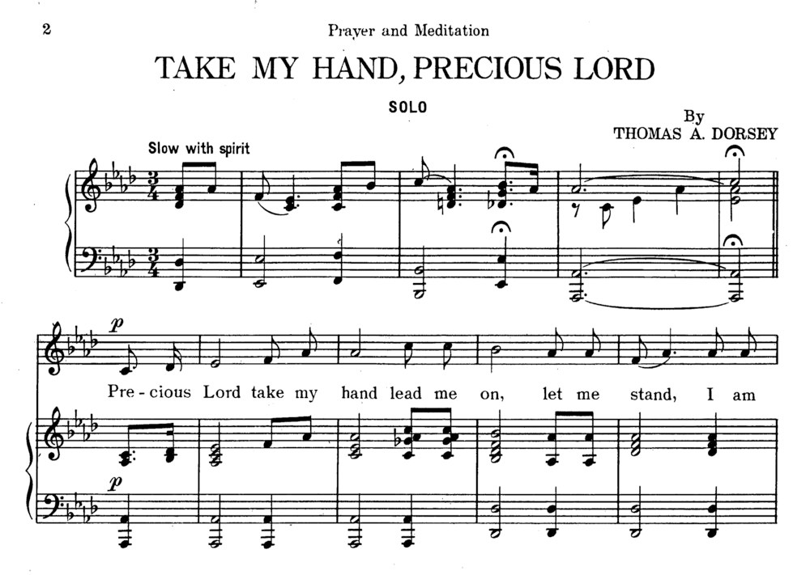
Over the next 60 years, Dorsey became known as the “Father of Gospel Music,” penning hundreds of songs. He always told others that his songs ‘carried a message’. “Nothing will take the place of gospel music. … Somebody might do it differently or add something to it, but any power in the music must come from God … and it’s all about what God wants.”

Slide 7
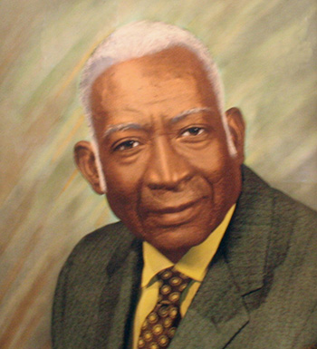
Dorsey’s songs shared the message of God’s love and care for his people. They gave hope to people.
“I kept pushing gospel because, somehow, I knew I was right. I knew I was the one the Master wanted to do it, and I did it.”

Slide 8
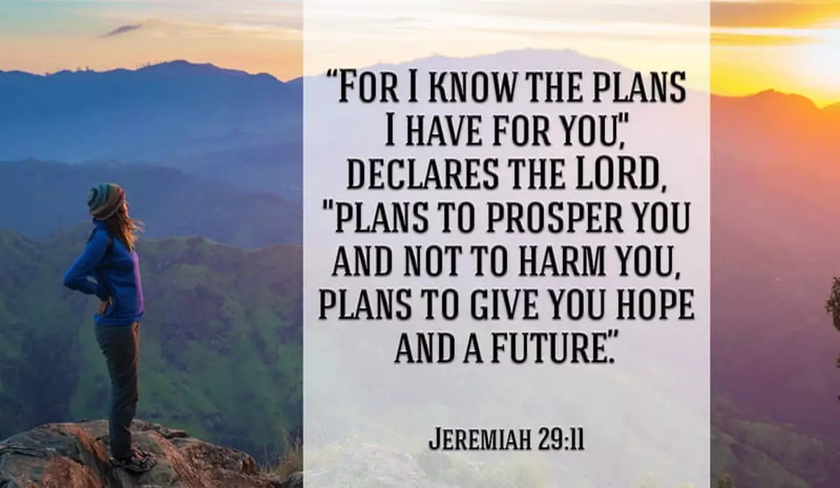
https://www.youtube.com/watch?v=oPB1sUR_yLg Here is one of the songs Thomas wrote. The Lord Will Make a Way Somehow.

Slide 9
Almighty Lord God, Give us true faith, and make that faith grow in us day by day. Also give us hope and love, so that we may serve our neighbours according to your will; through your Son, Jesus Christ our Lord, who lives and reigns with you and the Holy Spirit, one God, now and forever. Amen.

