Slide 1
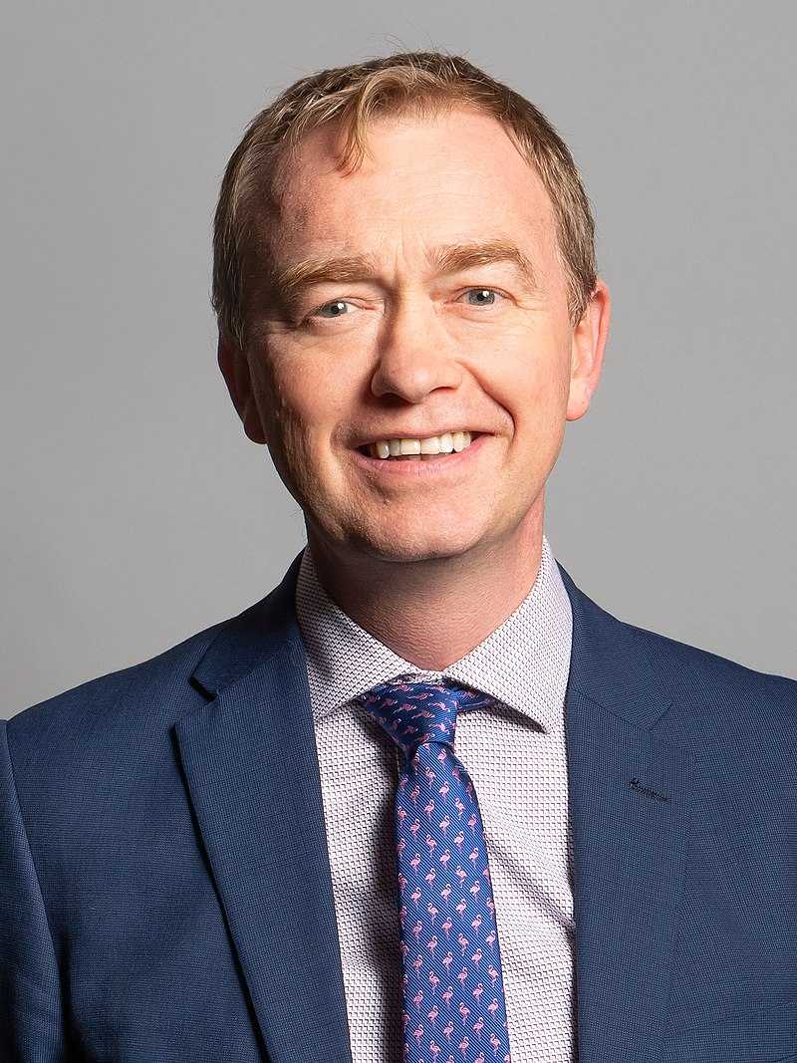
Tim Farron
Courageous Advocate of the Week

Slide 3
What does he do?
Tim is a politician
He works in the Houses of Parliament
He is a member of the Liberal Democrat party
He was the leader of the Lib Dems from 2015 to 2017
Why does he have a difficult job?
What problems could he face?

Slide 4
Crunch time
When he was leader, he was constantly asked about being a Christian
After the 2017 election, he had a choice to make:
Stay as leader and find it difficult to keep following Jesus
Stop being leader so he can follow Jesus better
Which would you choose?

Slide 5
What did he do?
Tim stepped down as the leader.
He said, “I am torn between living as a faithful Christian and serving as a political leader.”
What was more important for Tim?

Slide 6
End of a career?
Tim put Jesus first.
He continues to be a politician but is happy not being the leader.
In 2019 he published an autobiography ‘A Better Ambition’. Some people said his honesty ‘has put the nail in his political coffin’.
What does that phrase mean?
Do you think Tim cares? Why?

Slide 7
Let’s pray
Father God,
Help us when life gets hard and we have tricky decisions to make. We pray that you would give us the strength to do what is right.
We pray this in Jesus’ name,
Amen

