Slide 1
Alfie, Ethan and Nathan’s presentation
The Amazon

Slide 2
These facts are so cool they may blow your mind

Slide 3
Columbia
Columbia has lush rainforests, big mountains and coffee plantations
Columbia is very high up, it is one of the highest countries in the world
Columbia is named after the legendary explorer and navigator Christopher Columbus

Slide 4
This is the coldest waterfall in the Amazon

Slide 5
To get from Preston to the Amazon is 5,212 miles

Slide 6
These are just a few of the animals you may find in the Amazon. Anything from a Toucan to a poison frog

Slide 7
A large Rainforest tree in the depths of the Amazon – so tall!

Slide 8
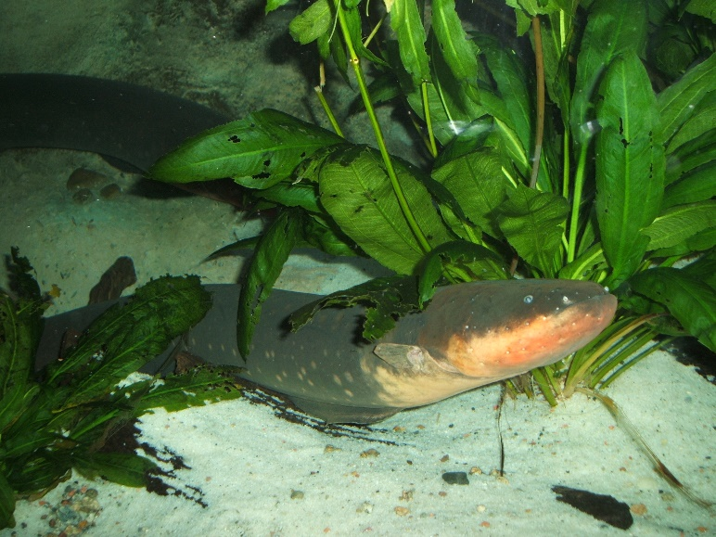
What is the Amazon?
The Amazon Rainforest is a large group of trees, thousands actually
They make the biggest rainforest in the universe
The main things that rainforests give us is Oxygen but sadly deforestation or burning down trees, is happening in the Amazon for more bigger shops
Now it is polluting air with the deadly toxic gases that come from the burning down trees. They could fall in the river and damage the home of the electric eel
And the Amazon habitats are being destroyed like monkeys, birds and all sorts of other exotic creatures in the Amazon

Slide 9
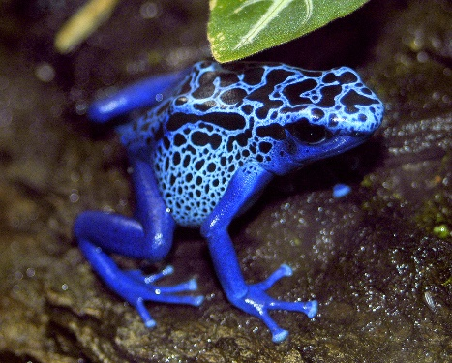
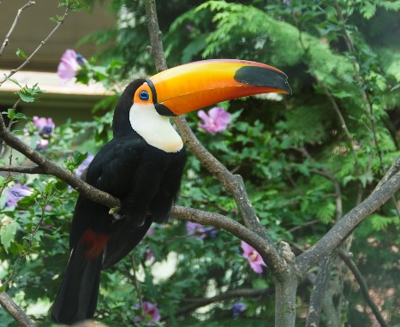
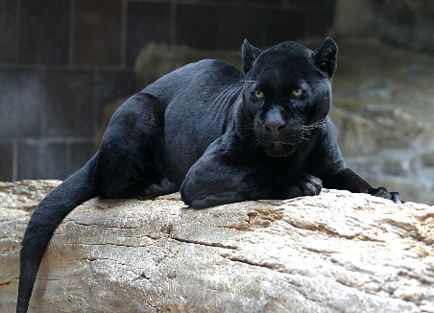
Creatures that live in the Amazon
Poison Arrow Frog is one of the most toxic creatures , or should I say amphibian, in the scary dark amazon
The Toucan is one brightly coloured bird. It can be so bright it might blind a scary insect
Our last animal is the ferocious black jaguar. It is the fastest creature in the murky amazon forest. It can grab piranha in its scary sharp claws.

Slide 10
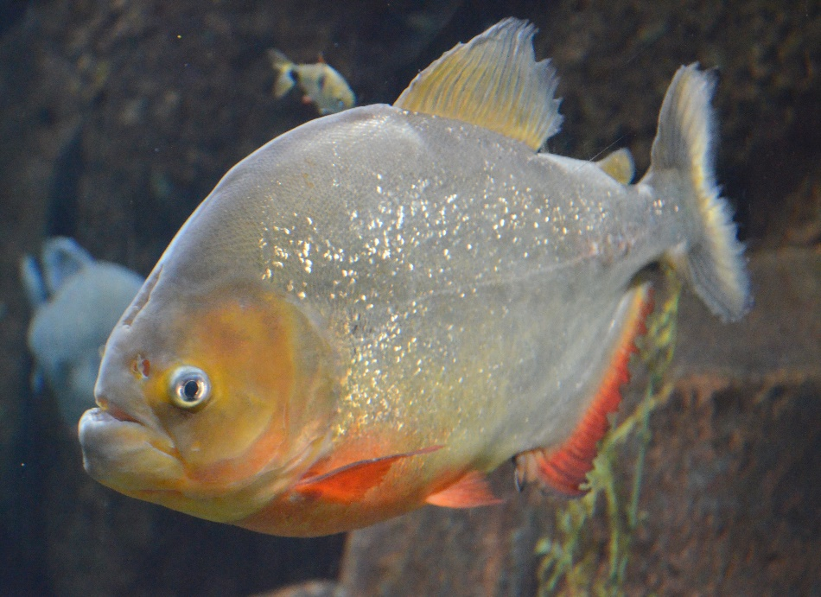
All about the river
The Amazon river is one of the coldest rivers in the world, also there is 2,000 species of butterflies
There are 20 species of piranha’s in the raging Amazon river
They are one of the deadliest species in the Amazon river. They are fierce and scary!
There are lots of tribes live in the Amazon and there is a city in that has 2 million people living there. There is an amusement park right in the centre of the city.

Slide 11
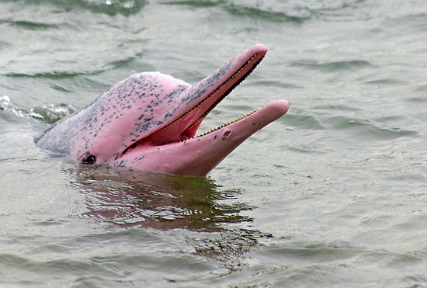
Facts about the Amazon River
It is the 2nd biggest river in the world, along with the river Nile
It has a lot of waterfalls in it and it also has a pink dolphin, known as Boto
The Amazon river bends and turns, called meanders. They are in the shape of a horse shoe.
The Amazon River begins in Peru. It has the second biggest fish in the world.

Slide 12
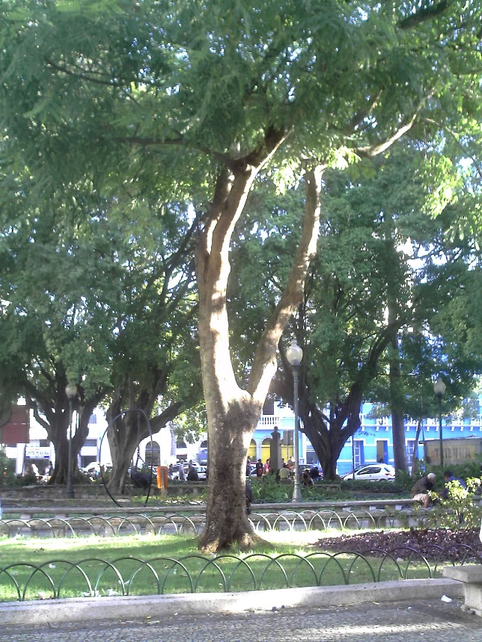
Facts about the countries the Amazon river runs through
It runs through Venezuela, Columbia, Brazil, Bolivia, Peru, Ecuador, Guyana and Rio De Janeiro
Now did you know that Brazil is actually named after a Brazil Wood Tree
Brazil is the biggest country in South America
The Amazon begins in Peru in ends at the Atlantic ocean
In the Amazon river, rivers join it. They are called tributaries.

Slide 13
Ecuador takes its name after the equator because it sits on the equator. Ecuador's flag has a little picture of the Amazon river, a boat is in it.

Slide 14
WHAT HAVE YOU LEARNED TODAY?

Slide 15
Thanks for listening

